Slide 1
Week 6 – Part II
Create Table

Slide 2
DECLARE & PRINT Command
Variables are declared in the body of a batch or procedure with the DECLARE statement and are assigned values by using either a SET or SELECT statement.
The main useage of DECLARE command is in the SQL procedures.
DECLARE @X1 INT ,@X2 INT
SELECT @X1 = 40
SELECT @X2 = 60
SELECT @X1 + @X2
PRINT 'This message will be displayed in the messages'

Slide 3
Go Statement
SQL Server utilities interpret GO as a signal that they should send the current batch of Transact-SQL statements to an instance of SQL Server.
USE AdventureWorks2014;
GO
DECLARE @MyMsg1 VARCHAR(50)
DECLARE @MyMsg2 VARCHAR(50)
SELECT @MyMsg1 = 'Hello, World.'
PRINT @MyMsg1
SELECT @MyMsg2 = 'Hello, College Students.'
GO -- @MyMsg2 and @MyMsg1 are not valid after this GO ends the batch.
-- Yields an error because @MyMsg2 not declared in this batch.
PRINT @MyMsg2
GO

Slide 4
CREATE TABLE Statement
The CREATE TABLE statement is used to create a new table in a database.
CREATE TABLE Colors (
ColorID int,
Color nvarchar(15)
);
Syntax
CREATE TABLE table_name ( column1 datatype, column2 datatype, column3 datatype, .... );
The CREATE DATABASE statement creates two files on the hard drive of the server:
A data file and a log file.

Slide 5
In-class exercise
1- Insert 3 rows of random data into the color table.
2- Show the data with a select command.
3- Delete the table.
SQL DROP TABLE Statement
DROP TABLE table_name;

Slide 6
Create Command
Primary Key and auto Increment and NOT NULL properties.
CREATE TABLE dbo.Colors (
ColorID int IDENTITY NOT NULL PRIMARY KEY,
Color nvarchar(15)
);
Primary key
Must be filled with data.
Auto Increment

Slide 7
In-class exercise
1- Insert 3 rows of random data into the color table.
Insert into colors (ColorID, Color)
values
(100, 'red'),
(200, 'Green'),
(1, 'Blue');
You might need to set your IDENTITY to ON.
SET IDENTITY_INSERT dbo.colors ON;
2- Show the data with a select command.
3- Delete all data from colors table and try the INSERT INTO command again
Insert into colors
values
(‘Yellow'),
(‘Purple'),
(‘Black');
You might need to set your IDENTITY to OFF First.
SET IDENTITY_INSERT dbo.colors OFF;

Slide 8
Insert using Select command
SELECT INTO statement allows you to create a new temporary or permanent table populated with the results of the defined SELECT statement.
The statement copies from the source :
Column names
Column Data Types
Null ability
IDENTITY property
Actual Data

Slide 9
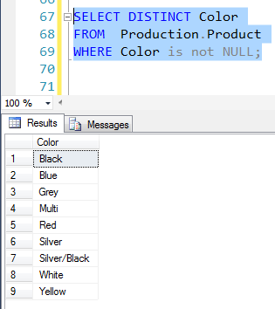
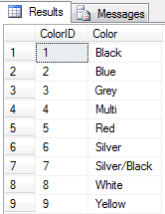
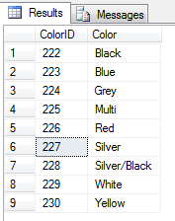
Insert using Select command
Delete all rows in the Colors table. (Use Delete command)
truncate table colors;
SELECT DISTINCT Color
FROM Production.Product
WHERE Color is not NULL
ORDER BY Color
Insert into Colors
SELECT DISTINCT Color
FROM Production.Product
WHERE Color is not NULL;
Insert into Colors
SELECT DISTINCT Color
FROM Production.Product
WHERE Color is not NULL;

Slide 10
Insert using Select command
SELECT * FROM Person.Person
SELECT * FROM Person.Person_Backup
SELECT * INTO Person.Person_Backup FROM Person.Person
(19972 row(s) affected)
SELECT LastName,FirstName INTO Person.Person_Backup1 FROM Person.Person
Where Title =‘Mr.’
(577 row(s) affected)

Slide 11
INSERT ….TOP
The TOP (n) or TOP (n) PERCENT clause specifies that only the first n number or percent of rows returned from the query result should be inserted using the INSERT statement.
INSERT table_name
TOP (n) [PERCENT]
[WITH TIES]
SELECT … FROM … [JOIN…][WHERE…]

Slide 12
INSERT ….TOP
CREATE TABLE dbo.SickLeave (
EmployeeID int,
FullName nvarchar (100),
SickLeaveHours int
)
INSERT INTO SickLeave -- Using INTO is optional here
SELECT TOP (10) PERCENT Person.Person.BusinessEntityID,
FirstName + ' ' + LastName, SickLeaveHours
FROM Person.Person JOIN
HumanResources.Employee
ON Person.Person.BusinessEntityID =
HumanResources.Employee.BusinessEntityID
ORDER BY SickLeaveHours DESC
SELECT *
FROM SickLeave
ORDER BY SickLeaveHours DESC;

